Slide 1
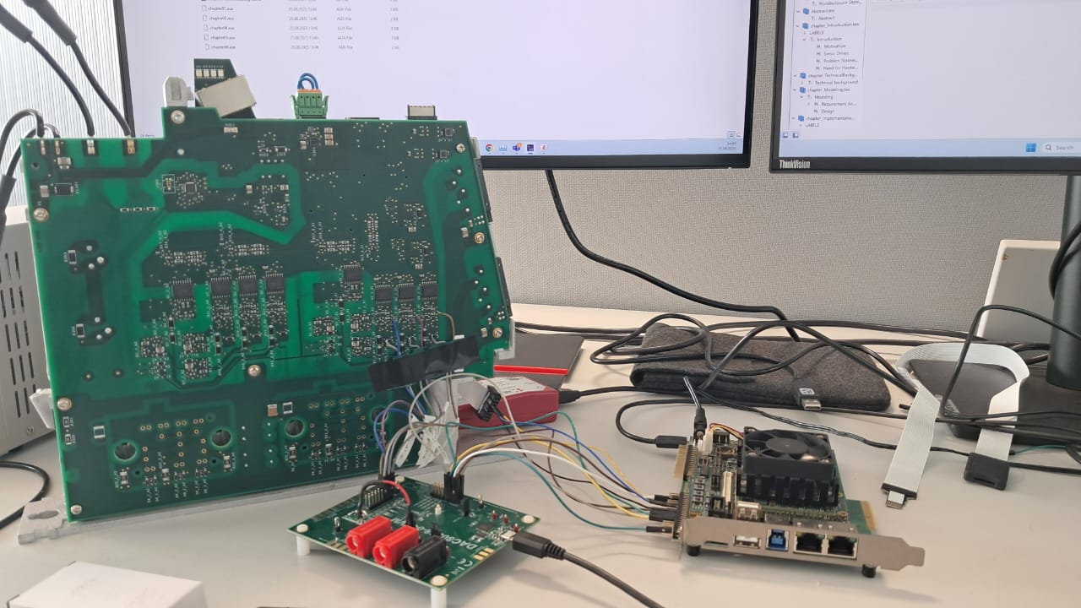
Career Snapshot

Slide 2
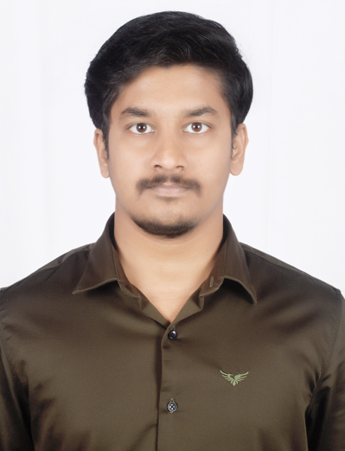
Who I am & What I Do
Master‘s Degree: Hochschule Darmstadt in Electrical Engineering and Informational Technology - International
Specialization: Embedded Systems.
Highly motivated FPGA Development Engineer and Embedded Systems professional with experience in Digital Hardware Design, and Embedded C/C++.
Proficient in VHDL/System Verilog and toolchains like Vivado, Vitis and Intel Quartus Prime.
Experience in designing hardware accelerators and complex communication architectures (AXI, SPI, I²C).

Slide 3
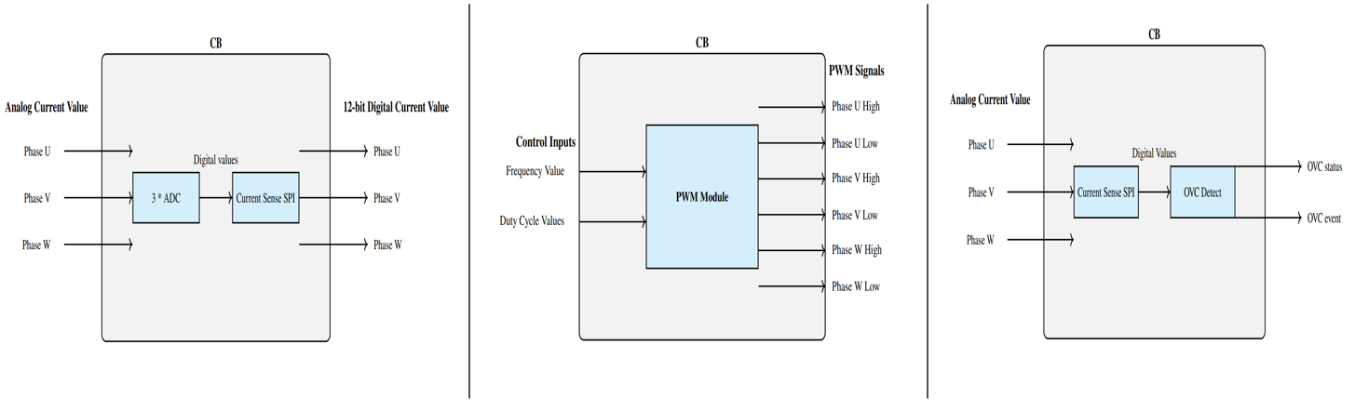
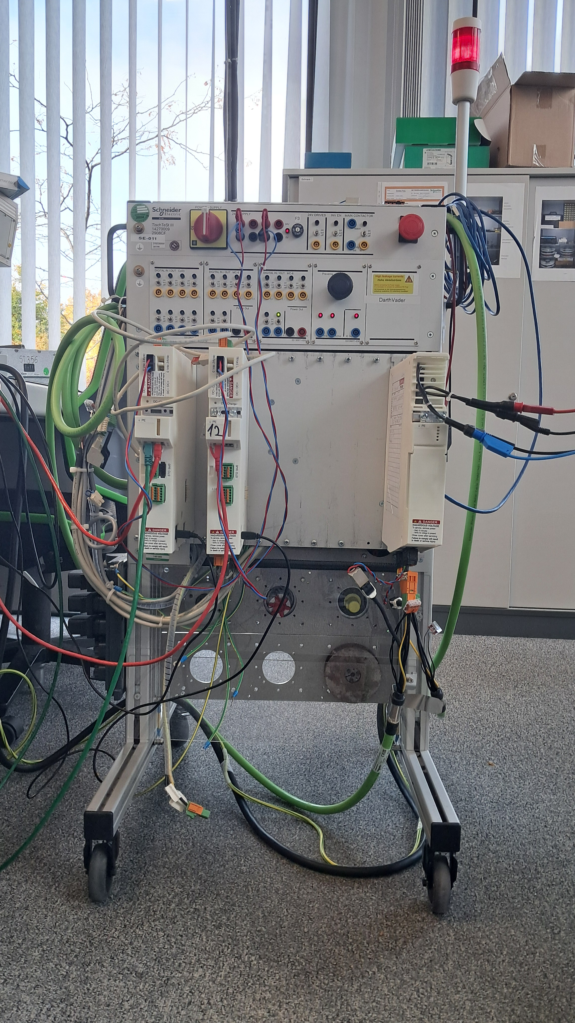
RAPID FPGA VERIFICATION STRATEGIES FOR SERVO DRIVES USING MPSOC
Manual and Resource – Intensive Verification Process.
Limited Test Coverage.
Dependence on Physical Hardware and Motors.
Inefficient Measurement Techniques.
Lack of Modular and Isolated FPGA Verification.

Slide 4
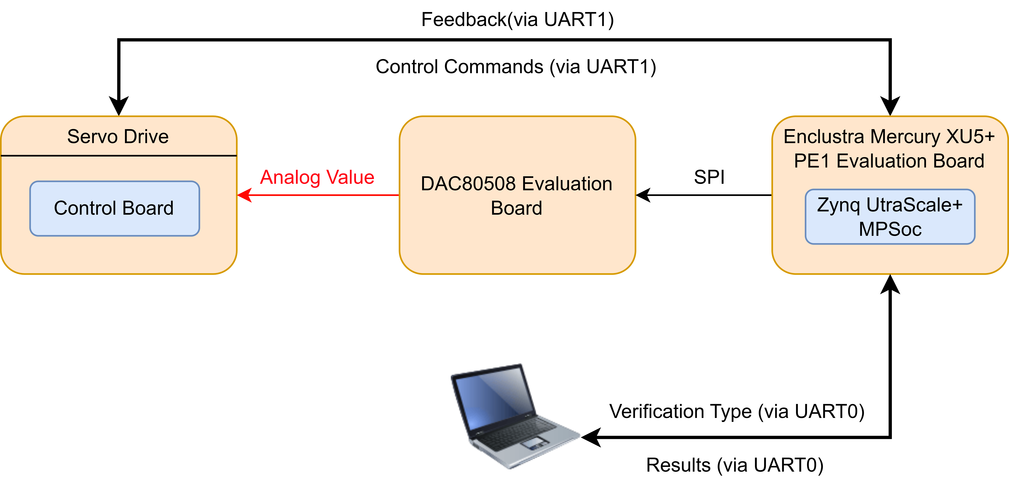
Block Diagram

Slide 5
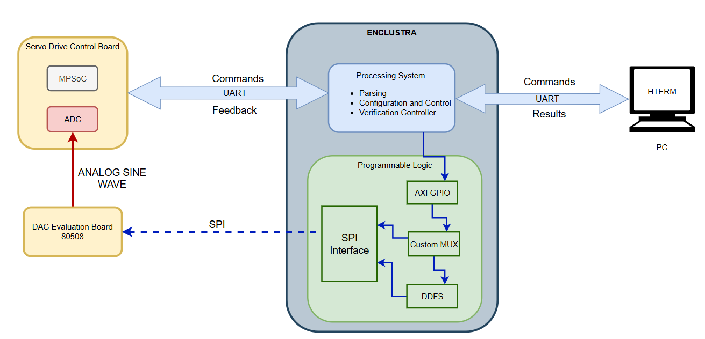
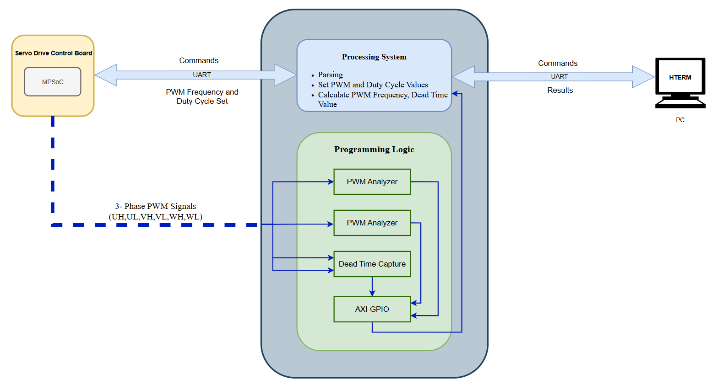

Slide 6
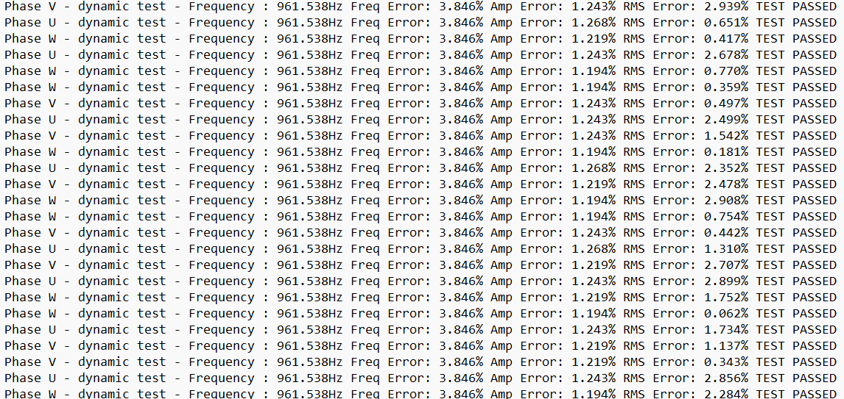
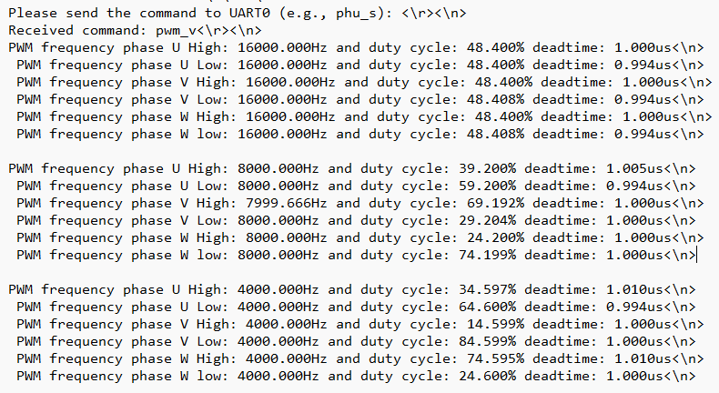

Slide 7
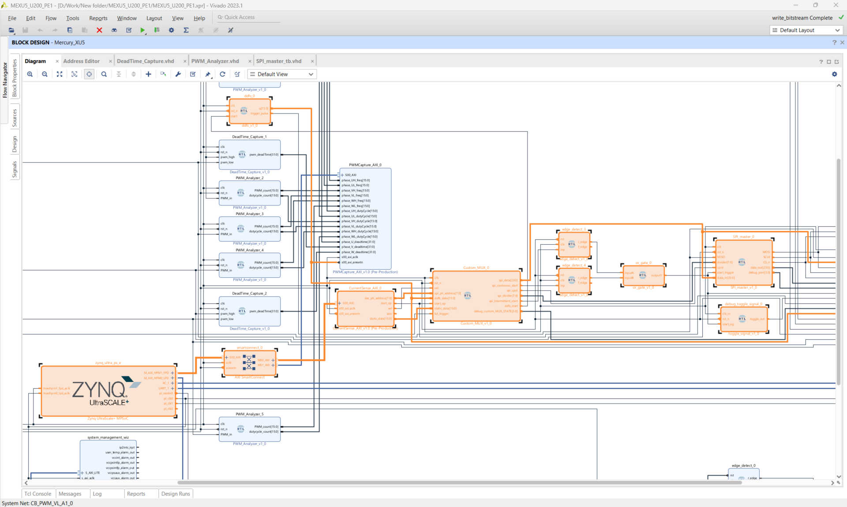
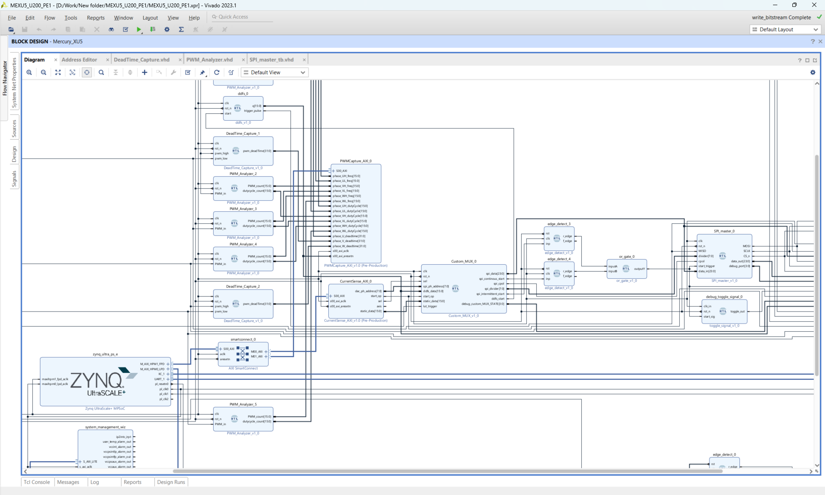
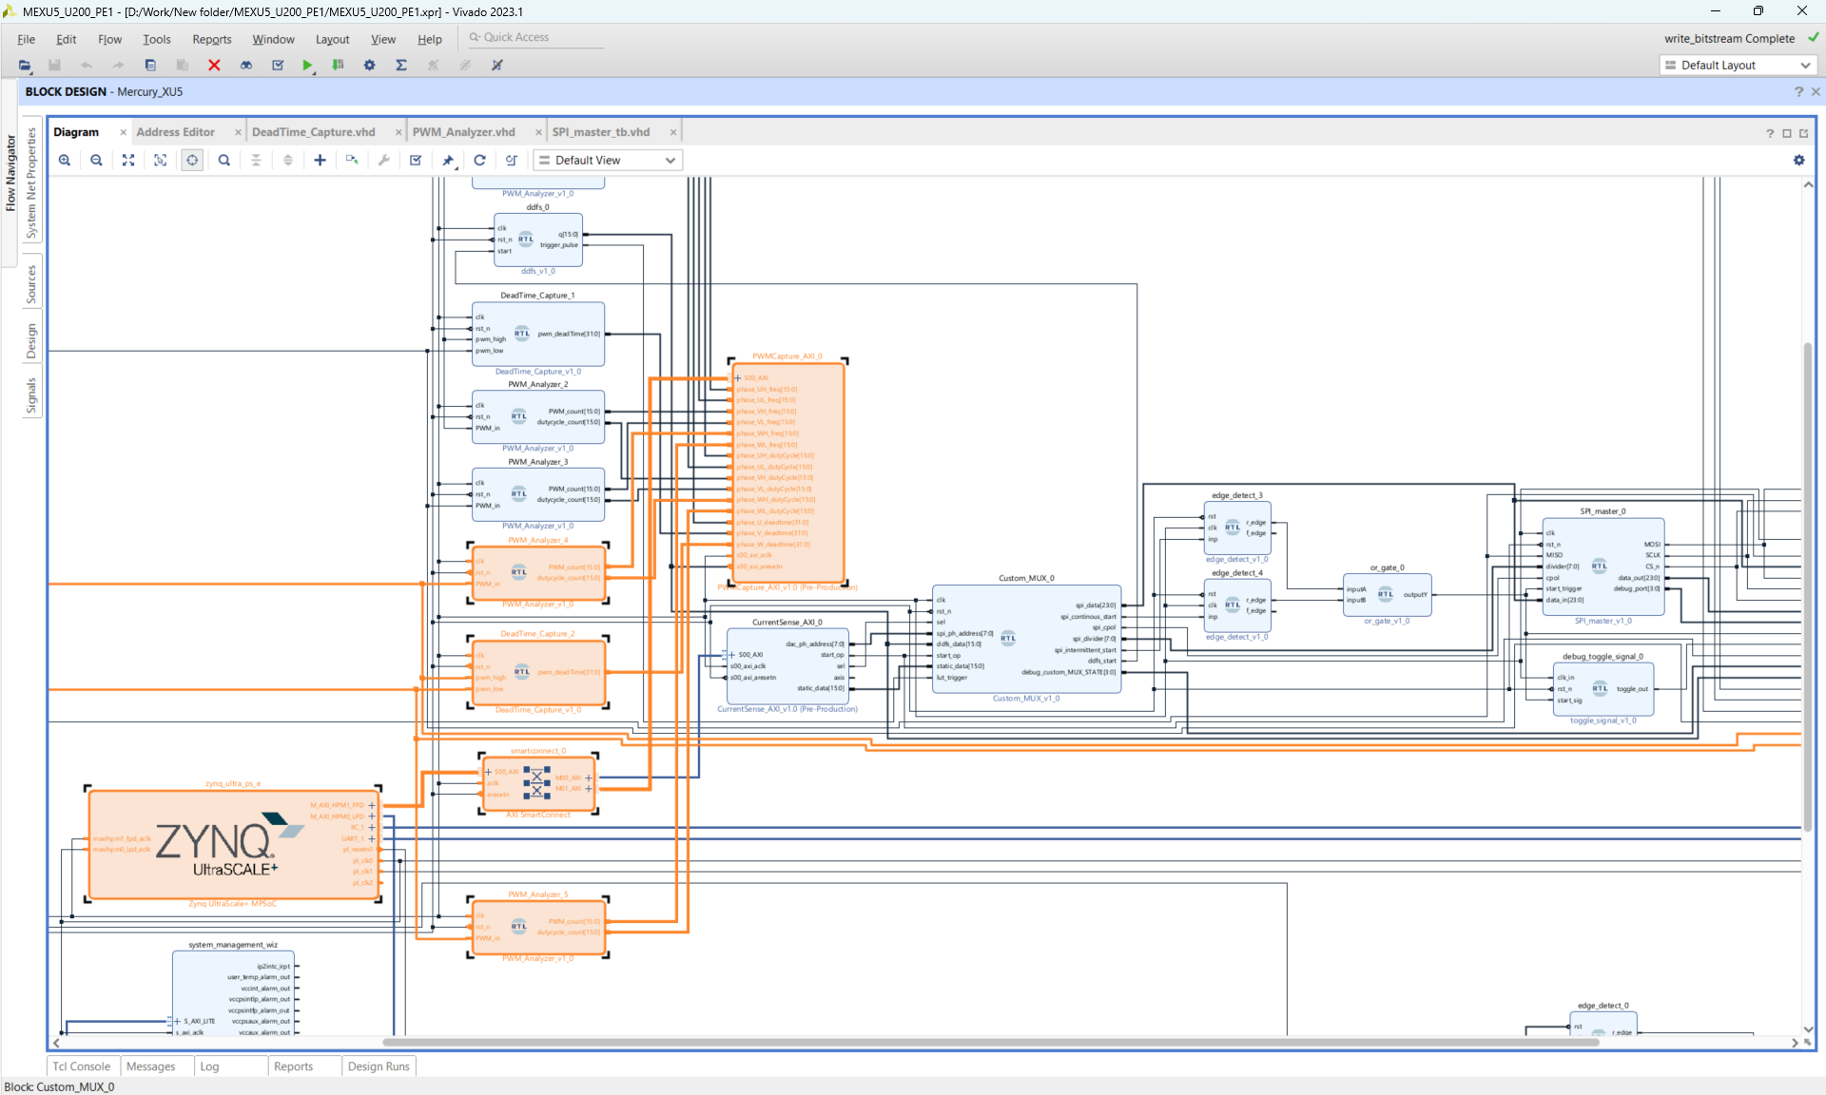

Slide 8
Internship at qutools GmbH
Developed high-speed hardware accelerator in VHDL to verify the Bell‘s inequality experiment, utilising FSM to cordinate complex control flows between actors and event handling.
Developed a custom Divide Entity using binary long-division algorithms and fixed-point athematic to perform real-time division of experimental data with configurable bit-widths for high precision.
Evaluated multiple RNG techniques, including LFSRs and modulo-based counters, to simulate quantum event ticks at Avalanche Photodiodes (APDs).
Built a user-centric GUI using the qudi framework and PySide2, employing a signal-slot mechanism and multithreading to decouple hardware control from the user interface.

Slide 9
Working Student Experiences at Schneider Electric and qutools GmbH
Designed and Implemented SPI and I2C communication protocols in VHDL.
Gained extensive hands-on experience with the Enclustra Mercury XU5-PE1 evaluation board.
Designed and implemented a Pulse Sequence Parser in C++, utilizing advanced programming techniques such as recursion, polymorphism, inheritance, object-oriented design, and templates.
THANK YOU

